Slide 1
Title: Improving Website Loading Speed Subtitle: Using Google PageSpeed Insights
SRINIVASA PRADEEP S

Slide 2
Introduction
Introduction to website performance optimization
Importance of fast loading websites for user experience and SEO
Overview of the project

Slide 3
Problem Statement
Slow website loading times negatively impact user experience and search engine rankings
Need for a reliable and efficient way to analyze and optimize website performance

Slide 4
Solution Overview
Using Google PageSpeed Insights to analyze website performance
Implementing optimization techniques based on analysis results
Providing users with actionable insights and recommendations

Slide 5
Platform Architecture
User Interface: Input URL, display performance reports
Backend: Fetch data from Google PageSpeed Insights, process and optimize data
Database: Store performance reports and historical data
Cache: Improve response times for frequently accessed data

Slide 6
Analysis Algorithm
Fetch performance data using Google PageSpeed Insights API
Analyze data to identify bottlenecks and optimization opportunities
Apply optimization techniques (e.g., image optimization, code minification, caching)
Provide actionable insights and recommendations

Slide 7
User Interface Design
Simple and intuitive interface for inputting website URL
Display of performance scores and detailed reports
Visualization of optimization opportunities and recommendations

Slide 8
Implementation
Steps to implement the solution
Key technologies used (Python, Google PageSpeed Insights API, Matplotlib for visualization)
Code snippets and explanations GIT LINK https://github.com/Srinivasa-Pradeep/Soc-Gen-Project.git

Slide 9
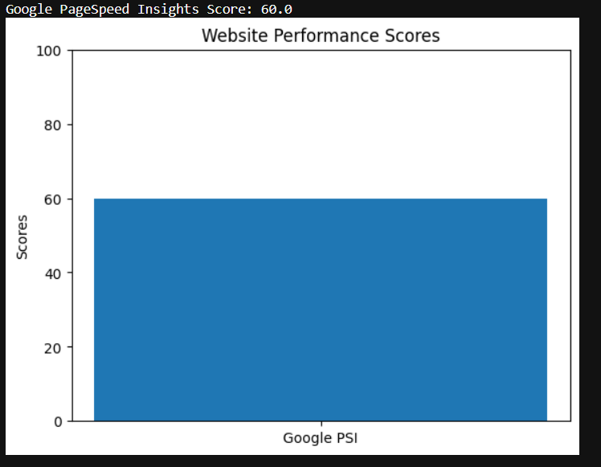
Results

